Slide 1


//Developers_Institute_
TLV Coding Bootcamp
Screen Time and Well-being: Exploring
Smartphone Usage Patterns and Business Opportunities
Developers Institute ranked for Best Coding Bootcamp Worldwide for 2023
Azerbaijan 🇦🇿- México 🇲🇽 - Cameroon 🇨🇲 - Senegal 🇸🇳 - Burkina Faso 🇧🇫 - Mali 🇲🇱 - Ghana 🇬🇭 - Togo 🇹🇬 - Mauritius 🇲🇺 - Morocco 🇲🇦 - India 🇮🇳 - Georgia 🇬🇪 - Israël 🇮🇱

Slide 2
Screen Time and Well-being: Exploring Smartphone Usage Patterns and Business Opportunities
Project Description
This project focuses on analyzing screen time patterns and app usage among different demographic groups. By examining how people interact with their smartphones, the project aims to uncover behavioral trends and highlight usage differences across various age and gender groups.
Goals and Problems Addressed
This project aims to solve key problems by analyzing how and when people spend time on their screens to uncover important patterns and trends. It provides businesses with valuable insights to create better apps and services that match users' needs.
By understanding how different groups use their devices, the project also helps businesses design solutions tailored to specific audiences.

Slide 3
Screen Time and Well-being: Exploring Smartphone Usage Patterns and Business Opportunities
Stack:
Python
Pandas
Machine Learning (K-Means)
Statistical Analysis
Data Visualization (Matplotlib, Seaborn & Plotly)
Jupyter Notebook (Google.coolab)
Tableau (Dashboard)

Slide 4
Screen Time and Well-being: Exploring Smartphone Usage Patterns and Business Opportunities
Dataset Overview:
Dataset Source: The dataset includes simulated user interaction data across various platforms, containing demographic, behavioral, and engagement metrics.
Size: The dataset includes 1000 rows and 32 columns.
Cleaning: Missing values were checked (none found), categorical variables were encoded for analysis, and some fields were reformatted for better analysis. Time was also segmented into morning, afternoon, and evening to provide deeper insights.

Slide 5
Screen Time and Well-being: Exploring Smartphone Usage Patterns and Business Opportunities
Project Objectives:
Analyze behavioral patterns of users based on demographic and usage patterns.
Identify correlations between psychological metrics (e.g., satisfaction, addiction level) and other features.
Segment users into clusters based on psychological metrics and explore differences in income, age, and platform usage.

Slide 6
Screen Time and Well-being: Exploring Smartphone Usage Patterns and Business Opportunities
Feature Correlations / Machine Learning:
Correlations: Strong correlations were observed among Productivity Loss, Satisfaction, Self Control, and Addiction Level. These were key metrics for clustering.
Clustering: K-Means clustering revealed three distinct user groups that significantly varied in psychological metrics but showed minimal differences in engagement or demographic variables.
Time of Day Analysis: Time of day strongly influenced psychological metrics, with higher addiction levels and lower self-control observed during the evening.

Slide 7
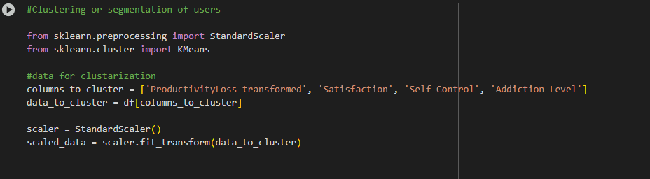
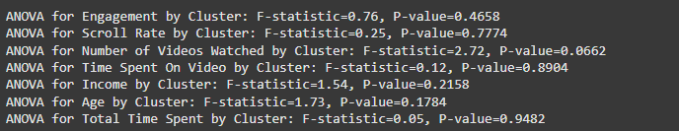
Screen Time and Well-being: Exploring Smartphone Usage Patterns and Business Opportunities
Feature Correlations / Machine Learning:

Slide 8
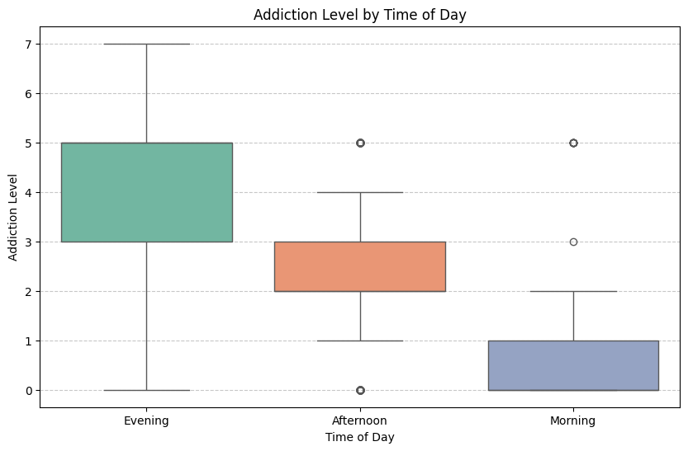
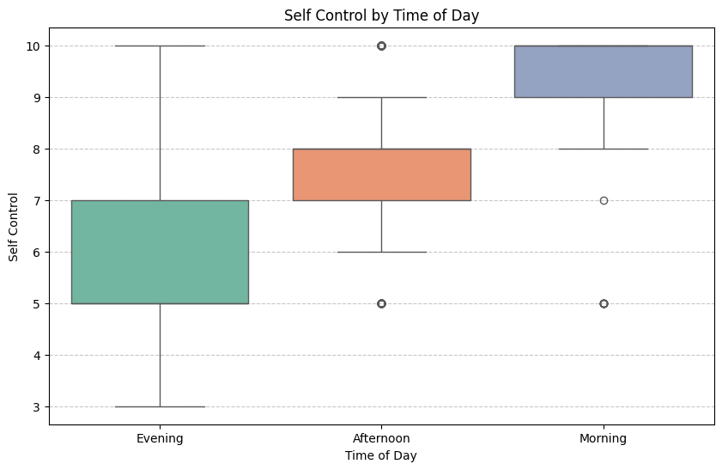
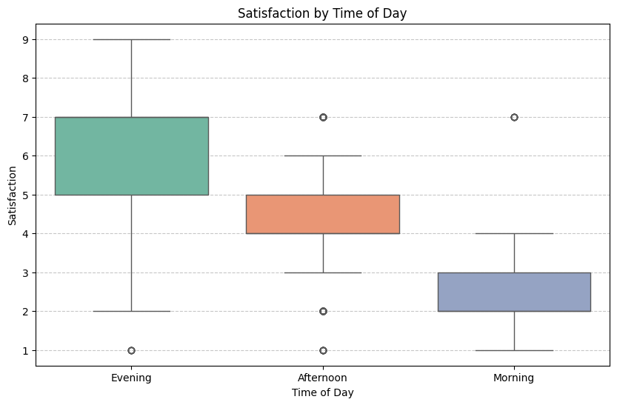
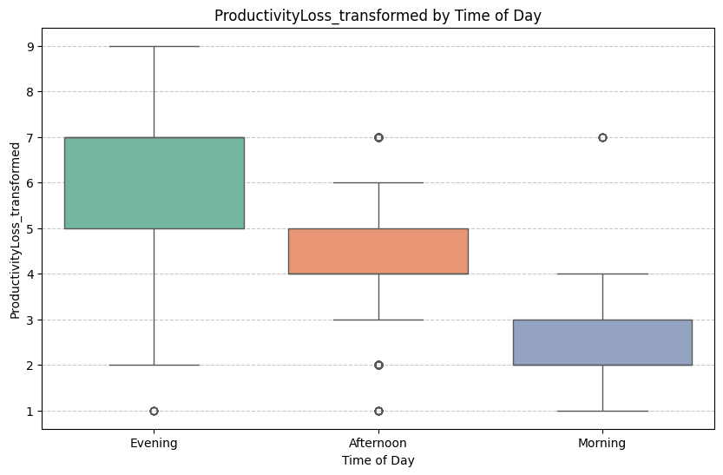
Screen Time and Well-being: Exploring Smartphone Usage Patterns and Business Opportunities

Slide 9
Screen Time and Well-being: Exploring Smartphone Usage Patterns and Business Opportunities
Limits:
Data Representation: The dataset is synthetic and might not fully show how people behave in real life.
Demographic Balance: Some groups (like rural or urban users) might have more or fewer people than expected.
Access to Real Data: Real datasets with these kinds of metrics are often not free and require payment, making it harder to use real-world information.
Future Improvements: Using real-world data, improving how we measure feelings like satisfaction, and trying predictive tools could make the analysis better.

Slide 10
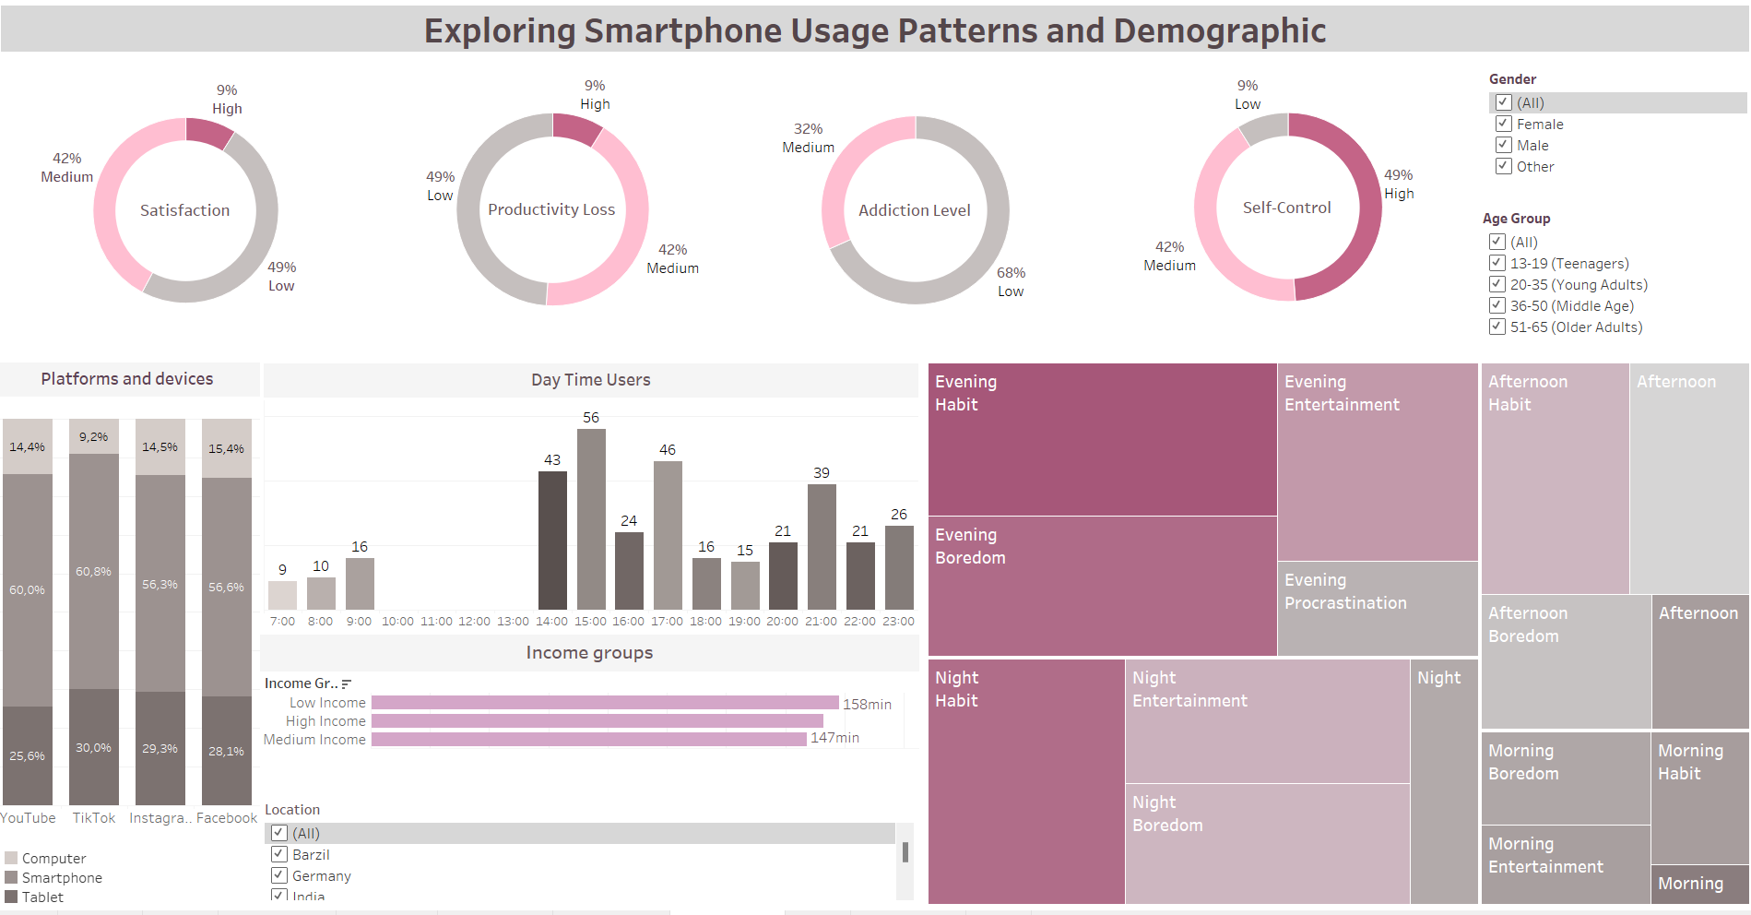
Screen Time and Well-being: Exploring Smartphone Usage Patterns and Business Opportunities

Slide 11
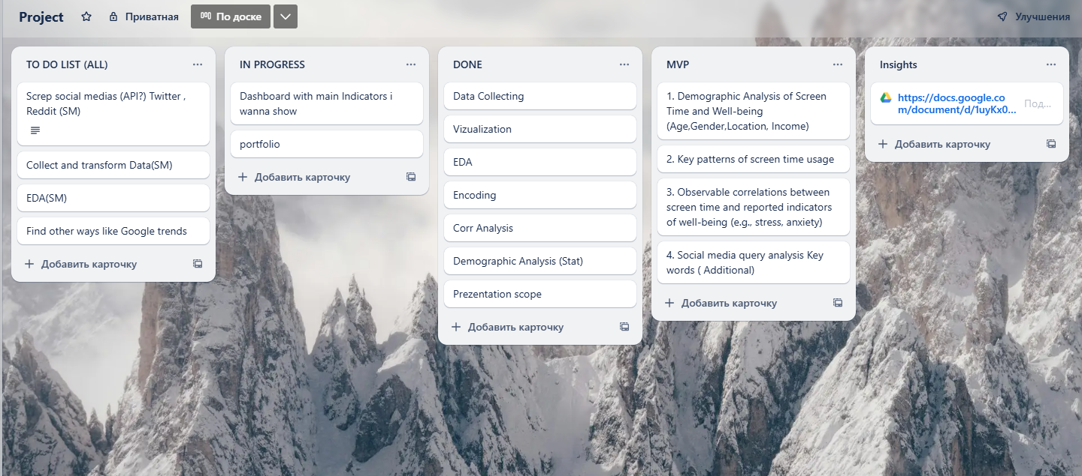
Screen Time and Well-being: Exploring Smartphone Usage Patterns and Business Opportunities

Slide 12
Screen Time and Well-being: Exploring Smartphone Usage Patterns and Business Opportunities
Links:
Github: https://github.com/ValentinaBogdanova/Screen_Time_and_Well_being_analysis
Video link: https://www.loom.com/share/4a6d11893e1146fe88ff0d8c11c1fef6?sid=1ffebb66-a5e9-47e3-bcea-6933a5cb5a58
Deployed link:
https://public.tableau.com/views/DashboardFinalProject_17375905308540/Dashboard1?:language=en-US&publish=yes&:sid=&:redirect=auth&:display_count=n&:origin=viz_share_link
Portfolio link: https://www.datascienceportfol.io/bogdanovavalya

Slide 13
Screen Time and Well-being: Exploring Smartphone Usage Patterns and Business Opportunities
Career Prep:
CV link: https://docs.google.com/document/d/1mYqD0qYXWnR_YrP8FZUkoDyE_N_4CIhu/edit?usp=sharing&ouid=117904512042212195918&rtpof=true&sd=true
Linkedin link: https://www.linkedin.com/in/valentina-bogdanova/
Job tracker link: https://docs.google.com/spreadsheets/d/1B9AwUQdZg5IDKVZupLmjJy9kGSdHlEx04tTdJNKNAmk/edit?usp=sharing

